Slide 1
SITE Reliability Engineering Training phase 1 – Dec 14to 23rd
Topics
S/W. Development Models
[ Agile, DevOps, DevSecOps]
SRE
Virtual Box, Vagrant, NGINX [ Linux]
Container - Dockers

Slide 2
Content [Module 2] Dec 14th – 18th
Vagrant
Nginx
Ubuntu/CentOS
Assignments

Slide 3
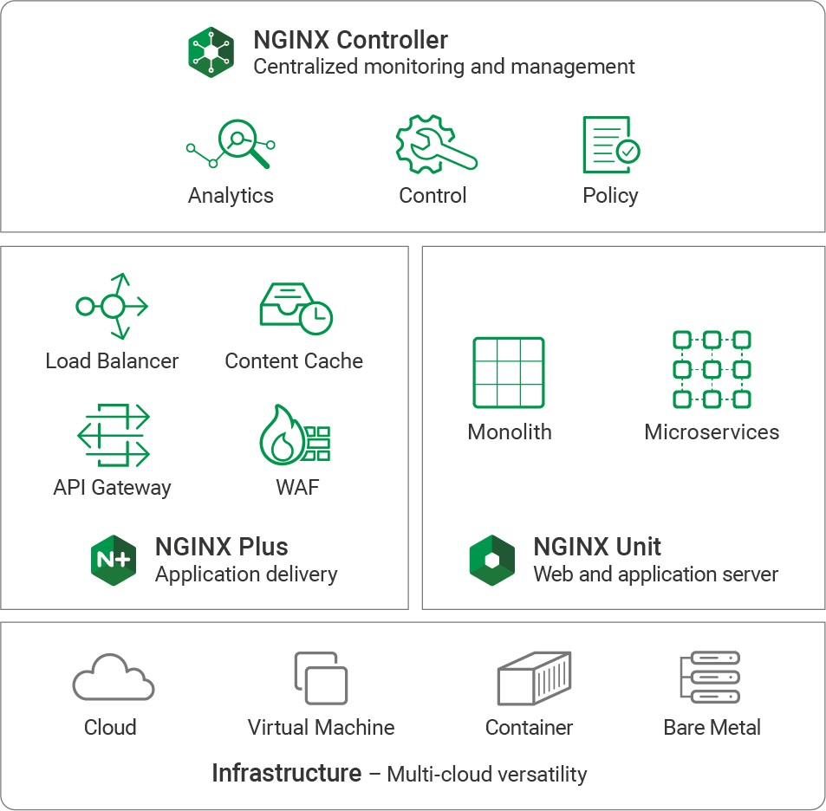
NGINX Application Platform
A suite of technologies to develop and deliver digital experiences that span from legacy, monolithic apps to modern, microservices apps.

Slide 4


Core Modules
•
•
•
•
•
•
•
•
Static Content (Web Server) TCP/UDP Load Balancing (L4) HTTP Load Balancing (L7)
Reverse Proxy (Advanced L7 Routing)
Security Controls
Media Delivery (VOD and Live Streaming)
HTTP Content Caching
Modularity (Extendable via Modules, Scripting)
15
#nginx #nginxconf

Slide 5
What is Nginx
Pronounced as “Engine X”
Open source web and reverse proxy server
High performance HTTP, HTTPS, SMTP, IMAP, POP3 server
Load balancing and HTTP caching
Asynchronous event-driven architecture

Slide 6






NGINX Overview
Web Server
Serve content from disk
HTTP Traffic
Internet
Reverse Proxy
Caching, load balancing…
Application Gateway
FastCGI, uWSGI, Passenger…

Slide 7
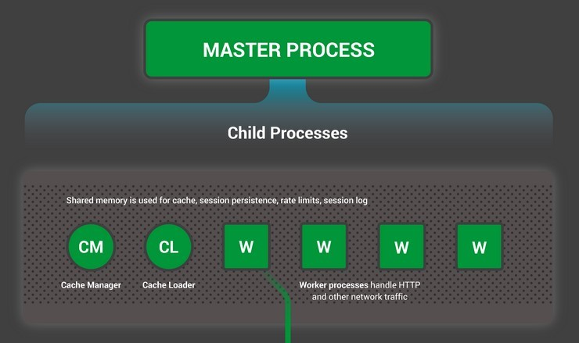
Nginx Process Model

Slide 8
Master process
Reads & validates configurations
Creates and binds sockets
Creates child processes
Cache loader → loads cache in memory Cache manager → prunes cache periodically
Worker processes → handles connections, IO and
communicate to upstream server

Slide 9
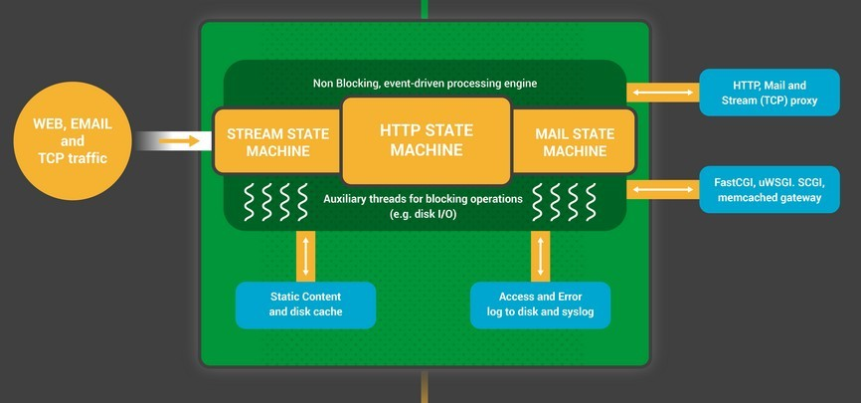
Child process

Slide 10
Child process
Worker is single threaded
One worker process per CPU core
# directive
worker_processes auto;
Communicate with each other using shared memory
Handles multiple connections asynchronously
Polls for events on listen & connection sockets
Events on listen sockets start a new connection
Events on connection socket handles subsequent requests
Connections are submitted to state machine
HTTP
Stream
Mail (SMTP, IMAP and POP3)

Slide 11
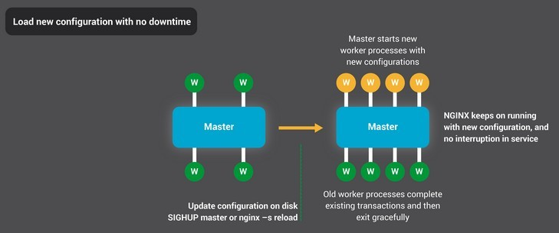
High availability

Slide 12
Why use Nginx
Lightweight with small memory footprint
Uses predictable memory under load
Provides high level of concurrency
Serves static content quickly
Handles connections asynchronously
Uses single thread

Slide 13
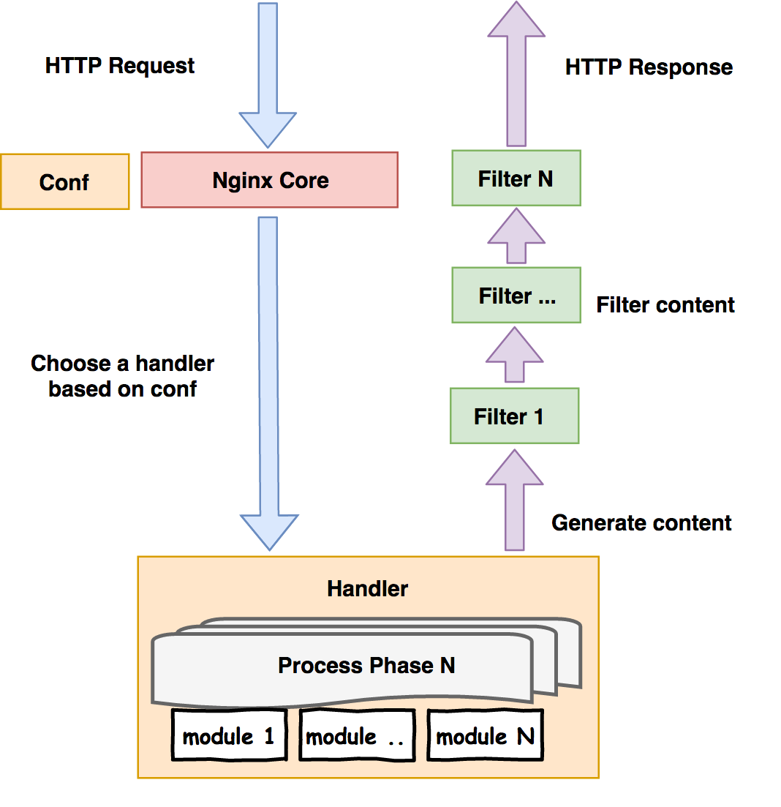
PROCESS FLOW

Slide 14
Installing Nginx
Add stable Nginx repository
sudo add-apt-repository ppa:nginx/stable
Update repositories
sudo apt-get update
Installing NGINX
sudo apt-get install nginx
Starting/restarting Nginx
Check that Nginx is running sudo service nginx status
Starting, stopping and restarting Nginx sudo service nginx start
sudo service nginx stop sudo service nginx restart

Slide 15
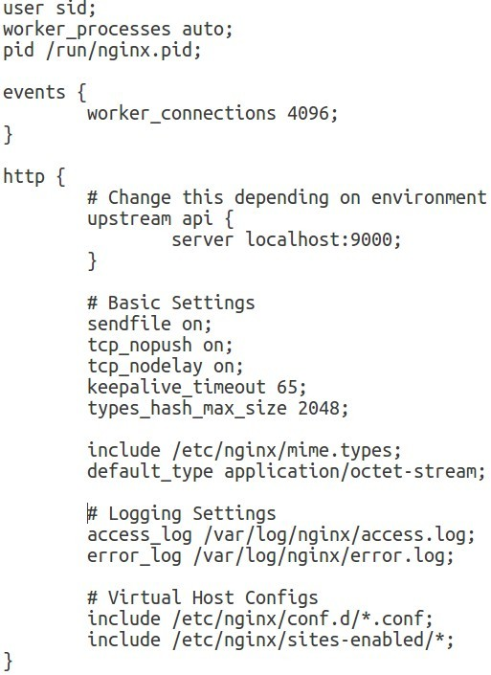
Nginx conf
main context
events context
http context
server context (nested context)

Slide 16
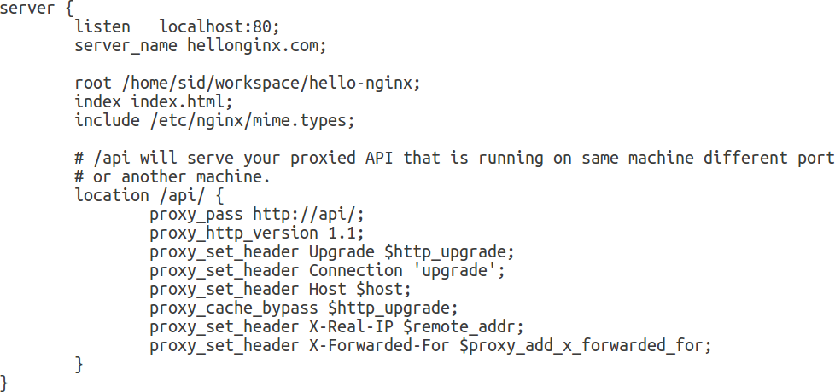
Server configurations

Slide 17
NGINX Installation: Debian/Ubuntu
Create /etc/apt/sources.list.d/nginx.list with the following contents:
deb http://nginx.org/packages/mainline/OS/ CODENAME nginx
deb-src http://nginx.org/packages/mainline/OS/ CODENAME nginx
OS – ubuntu or debian depending on your distro
CODENAME –
With debian: wheezy, jessie, or stretch (7.0, 8.0, 9.0)
With ubuntu: precise, trusty, xenial, or yakkety (12.04, 14.04, 16.04,
16.10)
$ wget http://nginx.org/keys/nginx_signing.key
$ apt-key add nginx_signing.key
$ apt-get update
$ apt-get install –y nginx

Slide 18
NGINX Installation: CentOS/RedHat
Create /etc/yum.repos.d/nginx.repo with the following contents:
[nginx] name=nginx repo
baseurl=http://nginx.org/packages/mainline/OS/OSRELEASE/$basearch/ gpgcheck=0
enabled=1
OS – centos or rhel depending on your distro
OSRELEASE – 6 or 7 for 6.x or 7.x versions, respectively
$ yum –y install nginx
$ systemctl enable nginx
$ systemctl start nginx
$ firewall-cmd --zone=public --add-port=80/tcp –permanent
$ firewall-cmd --reload
MORE INFORMATION AT NGINX.COM

Slide 19
Verifying Installation
$ nginx -v
nginx version: nginx/1.13.0
$ ps -ef | grep nginx
root 1088 1 0 19:59 ?
/usr/sbin/nginx -c /etc/nginx/nginx.conf
nginx 1092 1088 0 19:59 ?
00:00:00 nginx: master process
00:00:00 nginx: worker process

Slide 20
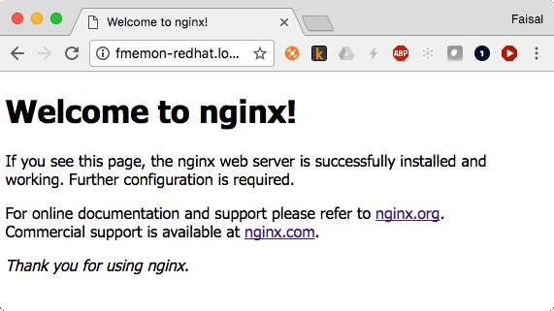
Verifying Installation

Slide 21
Key NGINX Commands
nginx –t Check if NGINX configuration is ok
nginx –s reload Gracefully reload NGINX processes
nginx –V Similar to –v, but with more detailed information
nginx –T Dump full NGINX configuration
nginx –h Display NGINX help menu
After config change, test and reload : nginx –t && nginx –s reload

Slide 22
Key Files and Directories
/etc/nginx/ − Parent directory for all NGINX configuration
/etc/nginx/nginx.conf − Top-level NGINX configuration, not modified often
/etc/nginx/conf.d/*.conf − Configuration for virtual servers and upstreams; for example, www.example.com.conf

Slide 23
Basic Web Server Configuration
server {
listen server_name
server defines the context for a virtual server
80 default_server; www.example.com;
listen specifies IP address/port that NGINX listens on; if no IP address (as here), NGINX binds to all IP addresses on system
location / {
root index
/usr/share/nginx/html; index.html index.htm;
default_server specifies to use this server if hostname is not known
}
server_name specifies hostname of virtual server
}
root specifies that:
www.example.com maps to /usr/share/nginx/html/index.html
www.example.com/i/file.txt maps to /usr/share/nginx/html/i/file.txt

Slide 24
Basic SSL Configuration
server {
listen server_name
Force all traffic to SSL
Good for SEO
Use Let’s Encrypt to get free SSL certificates
80 default_server; www.example.com;
return 301 https://$server_name$request_uri;
}
server {
listen 443 ssl default_server; server_name www.example.com;
ssl_certificate cert.crt ssl_certificate_key cert.key
location / {
root index
/usr/share/nginx/html; index.html index.htm;
}
}

Slide 25
Basic Reverse Proxy Configuration
server {
location ~ [^/]\.php(/|$) { fastcgi_split_path_info ^(.+?\.php)(/.*)$;
# fastcgi_pass 127.0.0.1:9000;
fastcgi_pass unix:/var/run/php7.0-fpm.sock;
fastcgi_index index.php; include fastcgi_params;
}
Requires PHP FPM:
apt-get install –y php7.0-fpm
Can also use PHP 5
Similar directives available for SCGI and uwsgi
Additional PHP FPM configuration may
be required

Slide 26
Basic Load Balancing Configuration
upstream my_upstream {
server server1.example.com; server server2.example.com; least_conn;
}
server {
location / {
proxy_set_header Host $host; proxy_pass http://my_upstream;
}
}
Default load balancing algorithm is Round Robin
least_conn selects server with fewest active
connections
By default NGINX rewrites Host header to name and port of proxied server
proxy_set_header overrides and passes through original client Host header
least_time factors in connection count and server response time (available in NGINX Plus only)

Slide 27
Basic Caching Configuration
proxy_cache_path /path/to/cache levels=1:2
keys_zone=my_cache:10m max_size=10g inactive=60m use_temp_path=off;
server {
location / {
proxy_cache my_cache;
proxy_set_header Host $host; proxy_pass http://my_upstream;
}
}
proxy_cache_path defines the size, location on disk, and other parameters of the cache
proxy_cache enables caching for the local context

Slide 28
Modifications to Main nginx.conf
user nginx;
worker_processes auto;
# ...
http {
# ...
keepalive_timeout 300s; keepalive_requests 100000;
}
Set in main nginx.conf file.
Default value for worker_processes varies by
system and installation source.
auto means to create one worker process per core. This is recommended for most deployments.
keepalive_timeout controls how long to keep idle
connections to clients open. Default: 75 seconds.
keeplive_requests sets the limit on requests by a single client connection before it’s closed.
keepalive_* can also be set per virtual server.

Slide 29
SSL Session Caching and HTTP/2
server {
listen 443 ssl http2 default_server; server_name www.example.com;
ssl_certificate cert.crt ssl_certificate_key cert.key
ssl_session_cache shared:SSL:10m; ssl_session_timeout 10m;
}
Improves SSL/TLS performance
1 MB session cache can store about 4,000
sessions
Cache shared across all NGINX workers
HTTP/2 improves performance
Note: HTTP/2 requires OpenSSL 1.0.2 to work properly

Slide 30
Improved Caching Configuration
proxy_cache_path /path/to/cache levels=1:2
keys_zone=my_cache:10m max_size=10g inactive=60m use_temp_path=off;
server {
location / {
proxy_cache my_cache;
proxy_cache_lock on; proxy_cache_revalidate on;
proxy_set_header Host $host; proxy_pass http://my_upstream;
}
}
proxy_cache_lock instructs NGINX to send only one request to the upstream when there are multiple cache misses for the same file
proxy_cache_revalidate
instructs NGINX to use
If-Modified-Since when
refreshing cache

Slide 31
Load Balancing with Health Checks Configuration
upstream my_upstream { zone my_upstream 64k;
server server1.example.com slow_start=30s;
server server2.example.com slow_start=30s;
}
server {
location / {
proxy_set_header Host $host; proxy_pass http://my_upstream;
}
location @health {
health_check mandatory;
}
}
Polls /health every 5 seconds
If response is not 2xx or 3xx, server
is marked as failed
Traffic to recovered/new servers slowly ramps up traffic over 30 seconds
Many additional configurable parameters
Exclusive to NGINX Plus

Slide 32
NGINX Stub Status Module
server {
location /basic_status { stub_status;
}
}
Provides aggregated NGINX statistics
Restrict access so it’s not publicly
visible
$ curl http://www.example.com/basic_status Active connections: 1
server accepts handled requests
7 7 7
Reading: 0 Writing: 1 Waiting: 0

Slide 33
Key Logging Files and Directories
/var/log/nginx/access.log − Details about requests and responses
/var/log/nginx/error.log − Details about NGINX errors

Slide 34
Summary
We recommend using the NGINX mainline branch for most deployments
Put all configuration in separate files in /etc/nginx/conf.d/
Forcing all traffic to SSL improves security and improves search rankings
Keepalive connections improve performance by reusing TCP connections
SSL session caching and HTTP/2 improve SSL performance
NGINX status module and logging capability provide visibility
Try NGINX Plus for free at nginx.com/free-trial-request

